Slide 1
Lecture 1
Software Re-engineering
Naveera Sami.

Slide 2
Today …
Review SE process
Discuss Reengineering Concepts
Go over some case studies, a road map to our lectures and tutorials:
VIM: componentization, reveal architectures osCommerce: aspect elicitation, reveal requirements

Slide 3
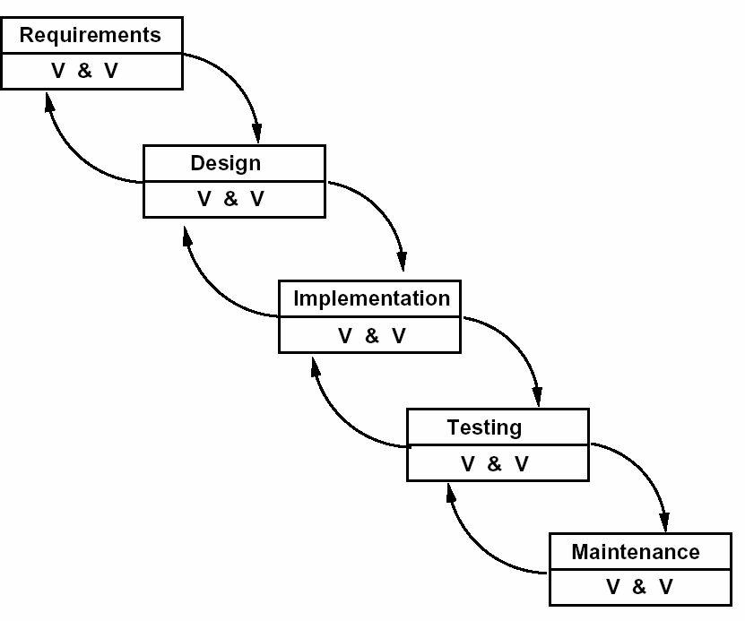
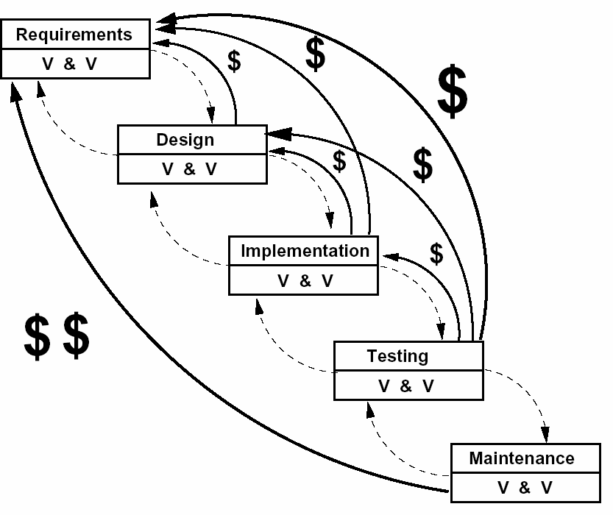
1. Software Engineering Process
The Waterfall process model

Slide 4
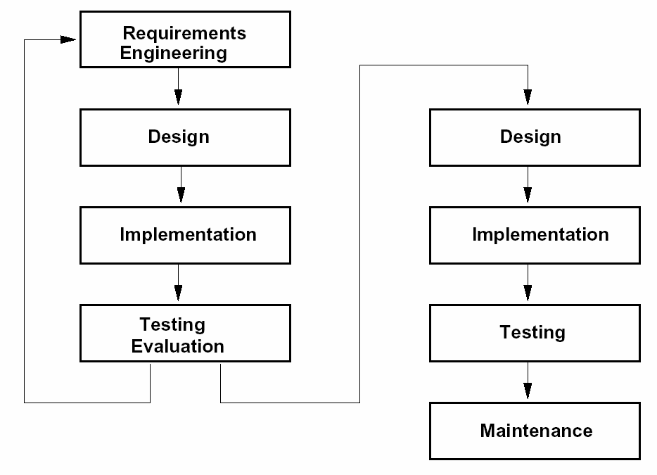
1. Software Engineering Process
Rapid Prototyping process

Slide 5
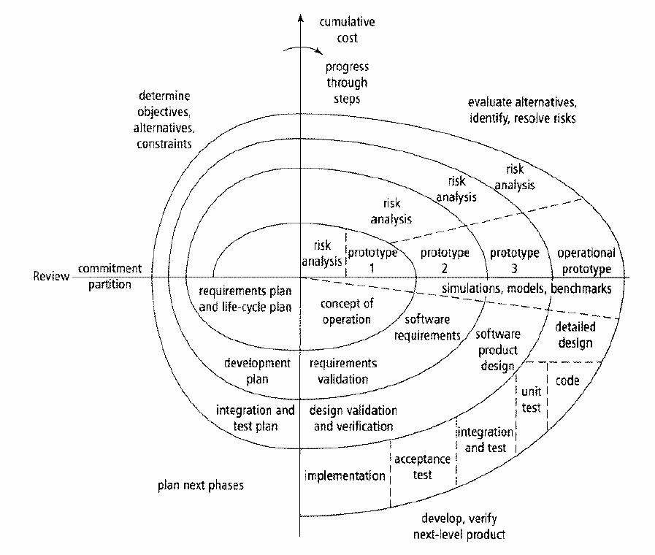
1. Software Engineering Process
Spiral (incremental) process

Slide 6
2. Reengineering concepts
Why Software Reengineering?
Legacy software are increasing (Software vs. Hardware)
New technology appearing (Moore’s law)
Successful ratio of projects increasing (IBM internal history)
Companies are more competing
(now we have the “open-source” movement and free-software foundation)
Quality attributes are demanding (That’s the selling point)
People are changing
(developers joining and leaving, customers are changing)
Software maintenance are pressing
(Largest cost in software development lifecycle >60%)

Slide 7
2. Reengineering concepts
What is software reengineering?
To a large extent, it involves maintenance activities:
Understanding (predictive)
Repairing (corrective)
Improving (perfective)
Evolving (adaptive)
Related topics
Quality-driven software engineering (-ilities, quality attributes)
Requirements engineering (goals, non-functional requirements)
Software architectures (architectural views: components, statecharts, features, …)
Model-driven development (MOF, UML, EMF)
Design patterns (structural, behavioural)
Software refactoring (the code smells)
Performance tuning (trade-offs, multi-criteria optimizations)
Paradigms: Object-oriented, Goal-oriented, Agent-oriented, Aspect-oriented…

Slide 8

2. Reengineering concepts The Horseshoe model

Slide 9





The Reengineering Horseshoe
Reverse engineering
Forward engineering
REQUIREMENTS
GOAL MODEL
Intentions
GOAL MODEL
Architectures
SOA
customizable architecture
STATECHARTS
Functions
Web services
components
LEGACY CODE
Source Code
……

Slide 10



Case Study I. VIM
VIM stands for Vi-IMproved http://www.vim.org
Are you a VIMer?
Current version 6.3
Bram Moolenaar
Developed in C
172 KLOC

Slide 11
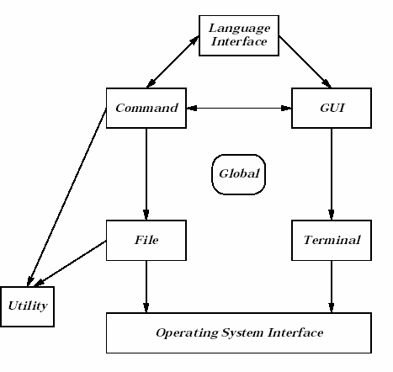
Understanding
the architecture of VIM
Lee’s initial VIM architecture

Slide 12
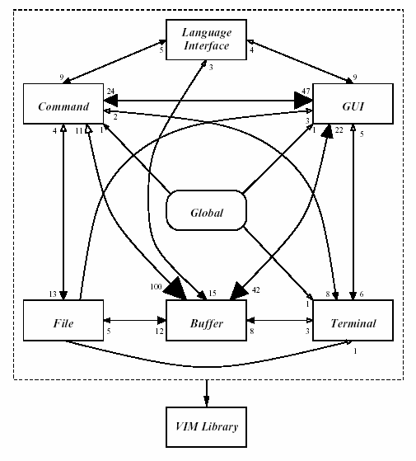
John Tran et al. “Architectural Repair of Open Source Software”, IWPC 2000.
Vim 5.3

Slide 13
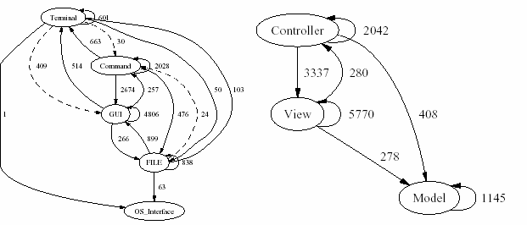
VIM 6.2

Slide 14
Summary
Reengineering is a hot topic in the software engineering research
Case studies show some ways to understand a legacy software
We will use several tutorials to explore further on individual case studies, explaining advanced topics on:
The concepts of software architecture (components, service-oriented architecture, build architecture), aspect-oriented paradigm, software refactoring
The software engineering tools for these tasks, including code fact extraction, reflexion model, Eclipse, aspectJ etc.
How to apply them to our course project

